Slide 1
Data Structures
17. Djikstra‘s Algorithm

Slide 2
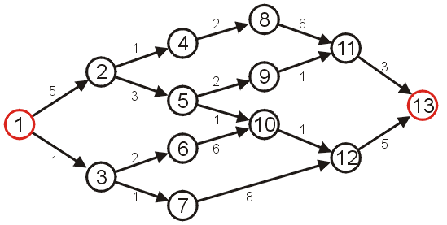
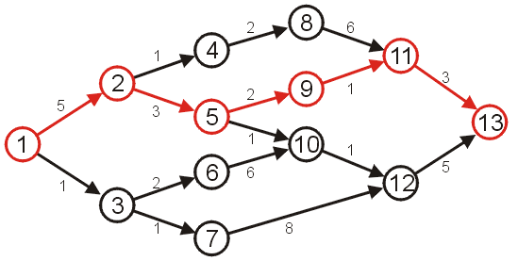
Shortest Path
Given a weighted graph
Problem is to find the shortest path between two given vertices
Length of a path in a weighted graph
Sum of the weights of each of the edges in that path
Example: Shortest path from vertex 1 to vertex 13
Other paths exists but they are longer

Slide 3
Application – Computer Networks
The Internet is a collection of interconnected computer networks
Information is passed through packets
Packets are passed from the source, through routers, to their destination
Routers are connected to either:
Individual computers, or
Other routers
These may be represented as graphs

Slide 4

Application – Computer Networks
A visualization of the graph of the routers and their various connections through a portion of the Internet
http://en.wikipedia.org/wiki/Internet

Slide 5
Application – Computer Networks
The path a packet takes depends on the IP address
Metrics for measuring the shortest path may include
Low latency (minimize time)
Minimum hop count (all edges have weight 1)

Slide 6
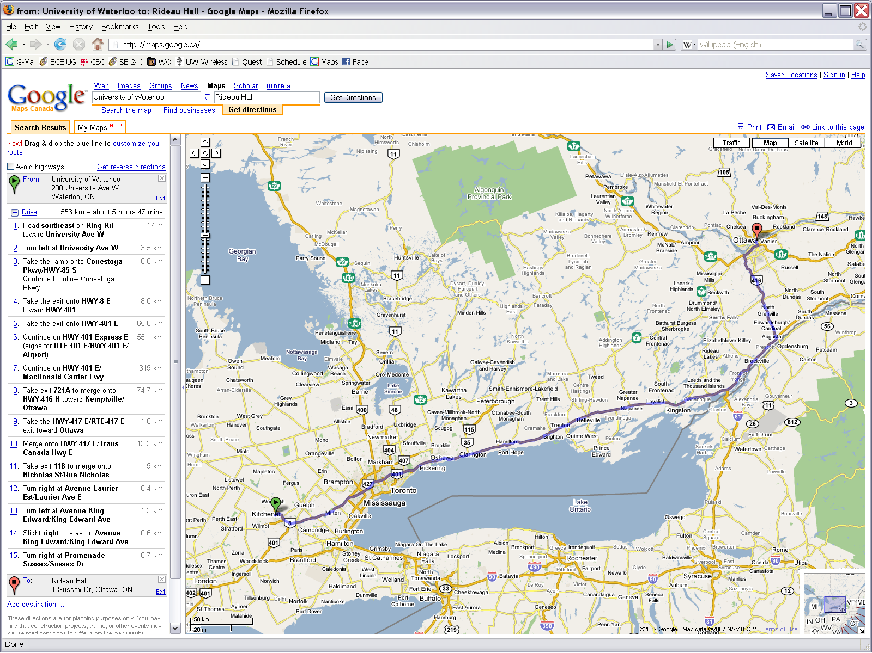
Application – Traffic
Find the shortest route between two points on a map
Shortest path, however, need not refer to distance...

Slide 7
Variants of Shortest Path
Given a graph G = (V, E)
Single-source shortest paths
Find shortest path from a given source vertex s to each vertex v ∈ V
Single-destination shortest paths
Find shortest path to a given destination vertex t from each vertex v
Single-pair shortest path
Find shortest path from u to v for given vertices u and v
All-pairs shortest-paths
Find shortest path from u to v for every pair of vertices u and v

Slide 8
Single Source Shortest Path

Slide 9
Dijkstra's Algorithm
Problem: From a given source vertex s∈V, find the shortest-paths and their weights w(s,v) for all v∈V
Idea of the Algorithm
Maintain a set S of vertices whose shortest-path distances from s are known
At each step add to S the vertex v∈ V–S whose distance estimate from s is minimal
Update the distance estimates of vertices adjacent to v

Slide 10
Dijkstra's Algorithm - Pseudocode
dist[s] = 0 // distance to source vertex is zero
p[s] = NULL for all v ∈ V–{s} dist[v] = ∞ // set all other distances to infinity S = ∅ //S, the set of visited vertices is initially empty Q = V //Q, the queue initially contains all vertices
while Q is not empty //while the queue is not empty u = mindistance(Q) //select the element of Q with the min distance S = S∪{u} // add u to list of visited vertices for all v ∈ neighbors[u] if dist[v] > dist[u] + w(u,v) //if new shortest path found dist[v] = dist[u] + w(u,v) //set new value of shortest path
p[v] = u

Slide 11
Dijkstra’s Vs. Prim’s Algorithm
Dijkstra’s Algorithm
dist[s] = 0
p[s] = NULL for all v ∈ V–{s} dist[v] = ∞ S = ∅ Q = V while (Q not empty) u = mindistance(Q) S = S∪{u} for all v ∈ neighbors[u] && v∈V-S if dist[u] + w(u, v) < dist[v] dist[v] = dist[u] + w(u, v)
p[v] = u
Prim’s Algorithm
Q = V[G];
for each u ∈ Q
key[u] = ∞;
key[r] = 0;
p[r] = NULL;
while (Q not empty)
u = ExtractMin(Q);
for each v ∈ Adj[u]
if (v ∈ Q and w(u,v) < key[v])
p[v] = u;
key[v] = w(u,v);

Slide 12
Dijkstra's Algorithm – Example
2
Q:
A
B
C
D
E
B
D
10
0
∞
∞
∞
∞
A
1
8
4
7
9
3
C
E
2
Vertex | Distance | Parent
A | 0 | Ø
B | ∞ | Ø
C | ∞ | Ø
D | ∞ | Ø
E | ∞ | Ø
Initialization
S: {}

Slide 13
Dijkstra's Algorithm – Example
2
Q:
A
B
C
D
E
B
D
10
0
∞
∞
∞
∞
A
1
8
4
7
9
3
C
E
2
Vertex | Distance | Parent
A | 0 | Ø
B | ∞ | Ø
C | ∞ | Ø
D | ∞ | Ø
E | ∞ | Ø
A ← EXTRACT-MIN(Q)
S: {A}

Slide 14
Dijkstra's Algorithm – Example
2
Q:
A
B
C
D
E
B
D
10
0
∞
∞
∞
∞
1
8
10
3
∞
∞
A
7
4
9
3
C
E
2
Vertex | Distance | Parent
A | 0 | Ø
B | 10 | A
C | 3 | A
D | ∞ | Ø
E | ∞ | Ø
Update all neighbors of A
S: {A}

Slide 15
Dijkstra's Algorithm – Example
2
Q:
A
B
C
D
E
B
D
10
0
∞
∞
∞
∞
1
8
10
3
∞
∞
A
7
4
9
3
C
E
2
Vertex | Distance | Parent
A | 0 | Ø
B | 10 | A
C | 3 | A
D | ∞ | Ø
E | ∞ | Ø
C ← EXTRACT-MIN(Q)
S: {A, C}

Slide 16
Dijkstra's Algorithm – Example
2
Q:
A
B
C
D
E
B
D
10
0
∞
∞
∞
∞
1
8
10
3
∞
∞
A
7
4
9
7
11
5
3
C
E
2
Vertex | Distance | Parent
A | 0 | Ø
B | 7 | C
C | 3 | A
D | 11 | C
E | 5 | C
Update all neighbors of C
S: {A, C}

Slide 17
Dijkstra's Algorithm – Example
2
Q:
A
B
C
D
E
B
D
10
0
∞
∞
∞
∞
1
8
10
3
∞
∞
A
7
4
9
7
11
5
3
C
E
2
Vertex | Distance | Parent
A | 0 | Ø
B | 7 | C
C | 3 | A
D | 11 | C
E | 5 | C
E ← EXTRACT-MIN(Q)
S: {A, C, E}

Slide 18
Dijkstra's Algorithm – Example
2
Q:
A
B
C
D
E
B
D
10
0
∞
∞
∞
∞
1
8
10
3
∞
∞
A
7
4
9
7
11
5
3
7
11
C
E
2
Vertex | Distance | Parent
A | 0 | Ø
B | 7 | C
C | 3 | A
D | 11 | C
E | 5 | C
Update all neighbors of E
S: {A, C, E}

Slide 19
Dijkstra's Algorithm – Example
2
Q:
A
B
C
D
E
B
D
10
0
∞
∞
∞
∞
1
8
10
3
∞
∞
A
7
4
9
7
11
5
3
7
11
C
E
2
Vertex | Distance | Parent
A | 0 | Ø
B | 7 | C
C | 3 | A
D | 11 | C
E | 5 | C
B ← EXTRACT-MIN(Q)
S: {A, C, E, B}

Slide 20
Dijkstra's Algorithm – Example
2
Q:
A
B
C
D
E
B
D
10
0
∞
∞
∞
∞
1
8
10
3
∞
∞
A
7
4
9
7
11
5
3
7
11
C
E
9
2
Vertex | Distance | Parent
A | 0 | Ø
B | 7 | C
C | 3 | A
D | 9 | B
E | 5 | C
Update all neighbors of B
S: {A, C, E, B}

Slide 21
Dijkstra's Algorithm – Example
2
Q:
A
B
C
D
E
B
D
10
0
∞
∞
∞
∞
1
8
10
3
∞
∞
A
7
4
9
7
11
5
3
7
11
C
E
9
2
Vertex | Distance | Parent
A | 0 | Ø
B | 7 | C
C | 3 | A
D | 9 | B
E | 5 | C
D ← EXTRACT-MIN(Q)
S: {A, C, E, B, D}

Slide 22
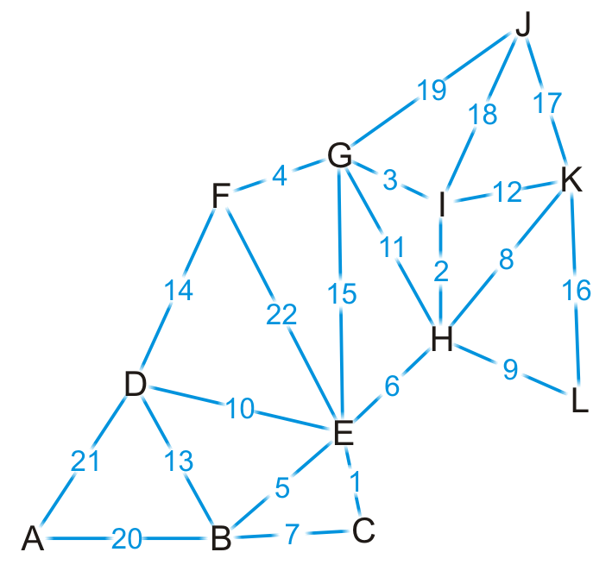
Dijkstra's Algorithm – Example
Find the shortest path from K to every other vertex

Slide 23
Dijkstra's Algorithm – Example
We visit vertex K
Vertex | S | Distance | Parent
A | F | ∞ | Ø
B | F | ∞ | Ø
C | F | ∞ | Ø
D | F | ∞ | Ø
E | F | ∞ | Ø
F | F | ∞ | Ø
G | F | ∞ | Ø
H | F | ∞ | Ø
I | F | ∞ | Ø
J | F | ∞ | Ø
K | T | 0 | Ø
L | F | ∞ | Ø

Slide 24
Dijkstra's Algorithm – Example
Vertex K has four neighbors: H, I, J and L
Vertex | S | Distance | Parent
A | F | ∞ | Ø
B | F | ∞ | Ø
C | F | ∞ | Ø
D | F | ∞ | Ø
E | F | ∞ | Ø
F | F | ∞ | Ø
G | F | ∞ | Ø
H | F | ∞ | Ø
I | F | ∞ | Ø
J | F | ∞ | Ø
K | T | 0 | Ø
L | F | ∞ | Ø

Slide 25
Dijkstra's Algorithm – Example
We have now found at least one path to each of these vertices
Vertex | S | Distance | Parent
A | F | ∞ | Ø
B | F | ∞ | Ø
C | F | ∞ | Ø
D | F | ∞ | Ø
E | F | ∞ | Ø
F | F | ∞ | Ø
G | F | ∞ | Ø
H | F | 8 | K
I | F | 12 | K
J | F | 17 | K
K | T | 0 | Ø
L | F | 16 | K

Slide 26
Dijkstra's Algorithm – Example
We’re finished with vertex K
To which vertex are we now guaranteed we have the shortest path?
mindistance(Q)
Vertex | S | Distance | Parent
A | F | ∞ | Ø
B | F | ∞ | Ø
C | F | ∞ | Ø
D | F | ∞ | Ø
E | F | ∞ | Ø
F | F | ∞ | Ø
G | F | ∞ | Ø
H | F | 8 | K
I | F | 12 | K
J | F | 17 | K
K | T | 0 | Ø
L | F | 16 | K

Slide 27
Dijkstra's Algorithm – Example
We visit vertex H: the shortest path is (K, H) of length 8
Vertex H has four unvisited neighbors: E, G, I, L
Vertex | S | Distance | Parent
A | F | ∞ | Ø
B | F | ∞ | Ø
C | F | ∞ | Ø
D | F | ∞ | Ø
E | F | ∞ | Ø
F | F | ∞ | Ø
G | F | ∞ | Ø
H | T | 8 | K
I | F | 12 | K
J | F | 17 | K
K | T | 0 | Ø
L | F | 16 | K

Slide 28
Dijkstra's Algorithm – Example
Consider these paths:
(K, H, E) of length 8 + 6 = 14 (K, H, G) of length 8 + 11 = 19
(K, H, I) of length 8 + 2 = 10 (K, H, L) of length 8 + 9 = 17
Which of these are shorter than any known path?
Vertex | S | Distance | Parent
A | F | ∞ | Ø
B | F | ∞ | Ø
C | F | ∞ | Ø
D | F | ∞ | Ø
E | F | ∞ | Ø
F | F | ∞ | Ø
G | F | ∞ | Ø
H | T | 8 | K
I | F | 12 | K
J | F | 17 | K
K | T | 0 | Ø
L | F | 16 | K

Slide 29
Dijkstra's Algorithm – Example
We already have a shorter path (K, L), but we update the others
Vertex | S | Distance | Parent
A | F | ∞ | Ø
B | F | ∞ | Ø
C | F | ∞ | Ø
D | F | ∞ | Ø
E | F | 14 | H
F | F | ∞ | Ø
G | F | 19 | H
H | T | 8 | K
I | F | 10 | H
J | F | 17 | K
K | T | 0 | Ø
L | F | 16 | K

Slide 30
Dijkstra's Algorithm – Example
We are finished with vertex H
Which vertex do we visit next?
Vertex | S | Distance | Parent
A | F | ∞ | Ø
B | F | ∞ | Ø
C | F | ∞ | Ø
D | F | ∞ | Ø
E | F | 14 | H
F | F | ∞ | Ø
G | F | 19 | H
H | T | 8 | K
I | F | 10 | H
J | F | 17 | K
K | T | 0 | Ø
L | F | 16 | K

Slide 31
Dijkstra's Algorithm – Example
The path (K, H, I) is the shortest path from K to I of length 10
Vertex I has two unvisited neighbors: G and J
Vertex | S | Distance | Parent
A | F | ∞ | Ø
B | F | ∞ | Ø
C | F | ∞ | Ø
D | F | ∞ | Ø
E | F | 14 | H
F | F | ∞ | Ø
G | F | 19 | H
H | T | 8 | K
I | T | 10 | H
J | F | 17 | K
K | T | 0 | Ø
L | F | 16 | K

Slide 32
Dijkstra's Algorithm – Example
Consider these paths:
(K, H, I, G) of length 10 + 3 = 13
(K, H, I, J) of length 10 + 18 = 28
Vertex | S | Distance | Parent
A | F | ∞ | Ø
B | F | ∞ | Ø
C | F | ∞ | Ø
D | F | ∞ | Ø
E | F | 14 | H
F | F | ∞ | Ø
G | F | 19 | H
H | T | 8 | K
I | T | 10 | H
J | F | 17 | K
K | T | 0 | Ø
L | F | 16 | K

Slide 33
Dijkstra's Algorithm – Example
We have discovered a shorter path to vertex G, but (K, J) is still the shortest known path to vertex J
Vertex | S | Distance | Parent
A | F | ∞ | Ø
B | F | ∞ | Ø
C | F | ∞ | Ø
D | F | ∞ | Ø
E | F | 14 | H
F | F | ∞ | Ø
G | F | 13 | I
H | T | 8 | K
I | T | 10 | H
J | F | 17 | K
K | T | 0 | Ø
L | F | 16 | K

Slide 34
Dijkstra's Algorithm – Example
Which vertex can we visit next?
Vertex | S | Distance | Parent
A | F | ∞ | Ø
B | F | ∞ | Ø
C | F | ∞ | Ø
D | F | ∞ | Ø
E | F | 14 | H
F | F | ∞ | Ø
G | F | 13 | I
H | T | 8 | K
I | T | 10 | H
J | F | 17 | K
K | T | 0 | Ø
L | F | 16 | K

Slide 35
Dijkstra's Algorithm – Example
The path (K, H, I, G) is the shortest path from K to G of length 13
Vertex G has three unvisited neighbors: E, F and J
Vertex | S | Distance | Parent
A | F | ∞ | Ø
B | F | ∞ | Ø
C | F | ∞ | Ø
D | F | ∞ | Ø
E | F | 14 | H
F | F | ∞ | Ø
G | T | 13 | I
H | T | 8 | K
I | T | 10 | H
J | F | 17 | K
K | T | 0 | Ø
L | F | 16 | K

Slide 36
Dijkstra's Algorithm – Example
Consider these paths:
(K, H, I, G, E) of length 13 + 15 = 28
(K, H, I, G, F) of length 13 + 4 = 17
(K, H, I, G, J) of length 13 + 19 = 32
Which do we update?
Vertex | S | Distance | Parent
A | F | ∞ | Ø
B | F | ∞ | Ø
C | F | ∞ | Ø
D | F | ∞ | Ø
E | F | 14 | H
F | F | ∞ | Ø
G | T | 13 | I
H | T | 8 | K
I | T | 10 | H
J | F | 17 | K
K | T | 0 | Ø
L | F | 16 | K

Slide 37
Dijkstra's Algorithm – Example
We have now found a path to vertex F
Vertex | S | Distance | Parent
A | F | ∞ | Ø
B | F | ∞ | Ø
C | F | ∞ | Ø
D | F | ∞ | Ø
E | F | 14 | H
F | F | 17 | G
G | T | 13 | I
H | T | 8 | K
I | T | 10 | H
J | F | 17 | K
K | T | 0 | Ø
L | F | 16 | K

Slide 38
Dijkstra's Algorithm – Example
Where do we visit next?
Vertex | S | Distance | Parent
A | F | ∞ | Ø
B | F | ∞ | Ø
C | F | ∞ | Ø
D | F | ∞ | Ø
E | F | 14 | H
F | F | 17 | G
G | T | 13 | I
H | T | 8 | K
I | T | 10 | H
J | F | 17 | K
K | T | 0 | Ø
L | F | 16 | K

Slide 39
Dijkstra's Algorithm – Example
The path (K, H, E) is the shortest path from K to E of length 14
Vertex G has four unvisited neighbors: B, C, D and F
Vertex | S | Distance | Parent
A | F | ∞ | Ø
B | F | ∞ | Ø
C | F | ∞ | Ø
D | F | ∞ | Ø
E | T | 14 | H
F | F | 17 | G
G | T | 13 | I
H | T | 8 | K
I | T | 10 | H
J | F | 17 | K
K | T | 0 | Ø
L | F | 16 | K

Slide 40
Dijkstra's Algorithm – Example
The path (K, H, E) is the shortest path from K to E of length 14
Vertex G has four unvisited neighbors: B, C, D and F
Vertex | S | Distance | Parent
A | F | ∞ | Ø
B | F | ∞ | Ø
C | F | ∞ | Ø
D | F | ∞ | Ø
E | T | 14 | H
F | F | 17 | G
G | T | 13 | I
H | T | 8 | K
I | T | 10 | H
J | F | 17 | K
K | T | 0 | Ø
L | F | 16 | K

Slide 41
Dijkstra's Algorithm – Example
Consider these paths:
(K, H, E, B) of length 14 + 5 = 19
(K, H, E, C) of length 14 + 1 = 15
(K, H, E, D) of length 14 + 10 = 24
(K, H, E, F) of length 14 + 22 = 36
Vertex | S | Distance | Parent
A | F | ∞ | Ø
B | F | ∞ | Ø
C | F | ∞ | Ø
D | F | ∞ | Ø
E | T | 14 | H
F | F | 17 | G
G | T | 13 | I
H | T | 8 | K
I | T | 10 | H
J | F | 17 | K
K | T | 0 | Ø
L | F | 16 | K

Slide 42
Dijkstra's Algorithm – Example
We’ve discovered paths to vertices B, C, D
Vertex | S | Distance | Parent
A | F | ∞ | Ø
B | F | 19 | E
C | F | 15 | E
D | F | 24 | E
E | T | 14 | H
F | F | 17 | G
G | T | 13 | I
H | T | 8 | K
I | T | 10 | H
J | F | 17 | K
K | T | 0 | Ø
L | F | 16 | K

Slide 43
Dijkstra's Algorithm – Example
Which vertex is next?
Vertex | S | Distance | Parent
A | F | ∞ | Ø
B | F | 19 | E
C | F | 15 | E
D | F | 24 | E
E | T | 14 | H
F | F | 17 | G
G | T | 13 | I
H | T | 8 | K
I | T | 10 | H
J | F | 17 | K
K | T | 0 | Ø
L | F | 16 | K

Slide 44
Dijkstra's Algorithm – Example
We’ve found that the path (K, H, E, C) of length 15 is the shortest path from K to C
Vertex C has one unvisited neighbor, B
Vertex | S | Distance | Parent
A | F | ∞ | Ø
B | F | 19 | E
C | T | 15 | E
D | F | 24 | E
E | T | 14 | H
F | F | 17 | G
G | T | 13 | I
H | T | 8 | K
I | T | 10 | H
J | F | 17 | K
K | T | 0 | Ø
L | F | 16 | K

Slide 45
Dijkstra's Algorithm – Example
The path (K, H, E, C, B) is of length 15 + 7 = 22
We have already discovered a shorter path through vertex E
Vertex | S | Distance | Parent
A | F | ∞ | Ø
B | F | 19 | E
C | T | 15 | E
D | F | 24 | E
E | T | 14 | H
F | F | 17 | G
G | T | 13 | I
H | T | 8 | K
I | T | 10 | H
J | F | 17 | K
K | T | 0 | Ø
L | F | 16 | K

Slide 46
Dijkstra's Algorithm – Example
Where to next?
Vertex | S | Distance | Parent
A | F | ∞ | Ø
B | F | 19 | E
C | T | 15 | E
D | F | 24 | E
E | T | 14 | H
F | F | 17 | G
G | T | 13 | I
H | T | 8 | K
I | T | 10 | H
J | F | 17 | K
K | T | 0 | Ø
L | F | 16 | K

Slide 47
Dijkstra's Algorithm – Example
We now know that (K, L) is the shortest path between these two points
Vertex L has no unvisited neighbors
Vertex | S | Distance | Parent
A | F | ∞ | Ø
B | F | 19 | E
C | T | 15 | E
D | F | 24 | E
E | T | 14 | H
F | F | 17 | G
G | T | 13 | I
H | T | 8 | K
I | T | 10 | H
J | F | 17 | K
K | T | 0 | Ø
L | T | 16 | K

Slide 48
Dijkstra's Algorithm – Example
Where to next?
Does it matter if we visit vertex F first or vertex J first?
Vertex | S | Distance | Parent
A | F | ∞ | Ø
B | F | 19 | E
C | T | 15 | E
D | F | 24 | E
E | T | 14 | H
F | F | 17 | G
G | T | 13 | I
H | T | 8 | K
I | T | 10 | H
J | F | 17 | K
K | T | 0 | Ø
L | T | 16 | K

Slide 49
Dijkstra's Algorithm – Example
Let’s visit vertex F first
It has one unvisited neighbor, vertex D
Vertex | S | Distance | Parent
A | F | ∞ | Ø
B | F | 19 | E
C | T | 15 | E
D | F | 24 | E
E | T | 14 | H
F | T | 17 | G
G | T | 13 | I
H | T | 8 | K
I | T | 10 | H
J | F | 17 | K
K | T | 0 | Ø
L | T | 16 | K

Slide 50
Dijkstra's Algorithm – Example
The path (K, H, I, G, F, D) is of length 17 + 14 = 31
This is longer than the path we’ve already discovered
Vertex | S | Distance | Parent
A | F | ∞ | Ø
B | F | 19 | E
C | T | 15 | E
D | F | 24 | E
E | T | 14 | H
F | T | 17 | G
G | T | 13 | I
H | T | 8 | K
I | T | 10 | H
J | F | 17 | K
K | T | 0 | Ø
L | T | 16 | K

Slide 51
Dijkstra's Algorithm – Example
Now we visit vertex J
It has no unvisited neighbors
Vertex | S | Distance | Parent
A | F | ∞ | Ø
B | F | 19 | E
C | T | 15 | E
D | F | 24 | E
E | T | 14 | H
F | T | 17 | G
G | T | 13 | I
H | T | 8 | K
I | T | 10 | H
J | T | 17 | K
K | T | 0 | Ø
L | T | 16 | K

Slide 52
Dijkstra's Algorithm – Example
Next we visit vertex B, which has two unvisited neighbors:
(K, H, E, B, A) of length 19 + 20 = 39
(K, H, E, B, D) of length 19 + 13 = 32
We update the path length to A
Vertex | S | Distance | Parent
A | F | 39 | B
B | T | 19 | E
C | T | 15 | E
D | F | 24 | E
E | T | 14 | H
F | T | 17 | G
G | T | 13 | I
H | T | 8 | K
I | T | 10 | H
J | T | 17 | K
K | T | 0 | Ø
L | T | 16 | K

Slide 53
Dijkstra's Algorithm – Example
Next we visit vertex D
The path (K, H, E, D, A) is of length 24 + 21 = 45
We don’t update A
Vertex | S | Distance | Parent
A | F | 39 | B
B | T | 19 | E
C | T | 15 | E
D | T | 24 | E
E | T | 14 | H
F | T | 17 | G
G | T | 13 | I
H | T | 8 | K
I | T | 10 | H
J | T | 17 | K
K | T | 0 | Ø
L | T | 16 | K

Slide 54
Dijkstra's Algorithm – Example
Finally, we visit vertex A
It has no unvisited neighbors and there are no unvisited vertices left
We are done
Vertex | S | Distance | Parent
A | T | 39 | B
B | T | 19 | E
C | T | 15 | E
D | T | 24 | E
E | T | 14 | H
F | T | 17 | G
G | T | 13 | I
H | T | 8 | K
I | T | 10 | H
J | T | 17 | K
K | T | 0 | Ø
L | T | 16 | K

Slide 55
Dijkstra's Algorithm – Example
Thus, we have found the shortest path from vertex K to each of the other vertices
Vertex | S | Distance | Parent
A | T | 39 | B
B | T | 19 | E
C | T | 15 | E
D | T | 24 | E
E | T | 14 | H
F | T | 17 | G
G | T | 13 | I
H | T | 8 | K
I | T | 10 | H
J | T | 17 | K
K | T | 0 | Ø
L | T | 16 | K

Slide 56
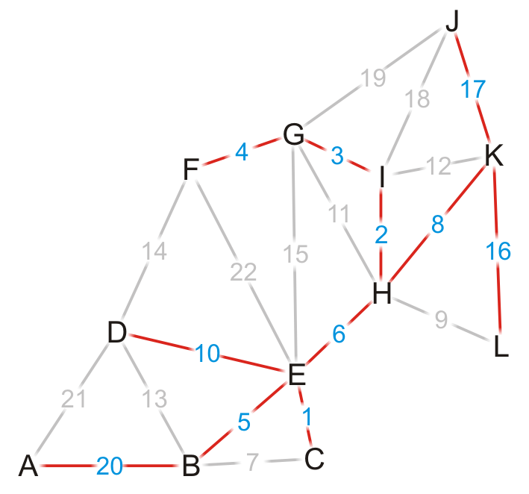
Dijkstra's Algorithm – Example
Using the previous pointers, we can reconstruct the paths
Vertex | S | Distance | Parent
A | T | 39 | B
B | T | 19 | E
C | T | 15 | E
D | T | 24 | E
E | T | 14 | H
F | T | 17 | G
G | T | 13 | I
H | T | 8 | K
I | T | 10 | H
J | T | 17 | K
K | T | 0 | Ø
L | T | 16 | K

Slide 57
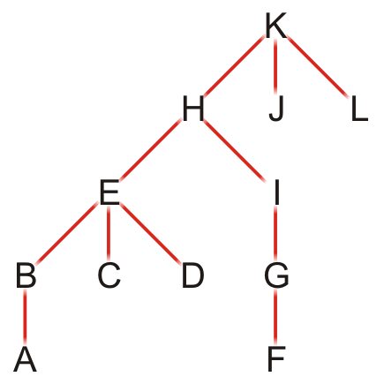
Dijkstra's Algorithm – Example
The table defines a rooted parental tree
The source vertex K is at the root
The previous pointer is the parent of the vertex in the tree
Vertex | Previous
A | B
B | E
C | E
D | E
E | H
F | G
G | I
H | K
I | H
J | K
K | Ø
L | K

Slide 58
Comments on Dijkstra’s Algorithm
If at some point, all unvisited vertices have a distance ∞?
This means that the graph is unconnected
We have found the shortest paths to all vertices in the connected subgraph containing the source vertex
To find the shortest path between vertices v_{j} and v_{k}?
Apply the same algorithm, but stop when visiting vertex v_{k}
Does the algorithm change if graph is directed?
No

Slide 59
Any Question So Far?

Slide 60
Dijkstra’s link-state routing algorithm
centralized: network topology, link costs known to all nodes
accomplished via “link state broadcast”
all nodes have same info
computes least cost paths from one node (“source”) to all other nodes
gives forwarding table for that node
iterative: after k iterations, know least cost path to k destinations
notation
c_{x,y}: direct link cost from node x to y; = ∞ if not direct neighbors
D(v): current estimate of cost of least-cost-path from source to destination v
p(v): predecessor node along path from source to v
N': set of nodes whose least-cost-path definitively known

Slide 61
Dijkstra’s link-state routing algorithm
1 Initialization:
2 N' = {u} /* compute least cost path from u to all other nodes */
3 for all nodes v
4 if v adjacent to u /* u initially knows direct-path-cost only to direct neighbors */
5 then D(v) = c_{u,v} /* but may not be minimum cost! */
6 else D(v) = ∞
7
8 Loop
9
10
11
12
13
14
15 until all nodes in N'
find w not in N' such that D(w) is a minimum
add w to N'
update D(v) for all v adjacent to w and not in N' :
D(v) = min ( D(v), D(w) + c_{w,v} )
/* new least-path-cost to v is either old least-cost-path to v or known
least-cost-path to w plus direct-cost from w to v */

Slide 62
Dijkstra’s algorithm: an example
v
w
x
y
z
Step
0
1
2
3
4
5
N'
D(v),p(v)
D(w),p(w)
D(x),p(x)
D(y),p(y)
D(z),p(z)
u
2,u
5,u
1,u
∞
∞
D(w),p(w)
5,u
4,x
3,y
3,y
5
Initialization (step 0):
For all a: if a adjacent to u then D(a) = c_{u,a}
v
3
w
2
5
u
2
1
z
3
1
x
2
1
y

Slide 63
Dijkstra’s algorithm: an example
v
w
x
y
z
Step
0
1
2
3
4
5
N'
D(v),p(v)
D(w),p(w)
D(x),p(x)
D(y),p(y)
D(z),p(z)
u
2,u
5,u
1,u
∞
∞
ux
D(w),p(w)
5,u
4,x
3,y
3,y
8 Loop
9
10
find a not in N' such that D(a) is a minimum
add a to N'
5
v
3
w
2
5
u
2
1
z
3
1
x
2
1
y

Slide 64

Dijkstra’s algorithm: an example
v
w
x
y
z
Step
0
1
2
3
4
5
N'
D(v),p(v)
D(w),p(w)
D(x),p(x)
D(y),p(y)
D(z),p(z)
u
2,u
5,u
1,u
∞
∞
ux
2,u
4,x
2,x
∞
D(w),p(w)
5,u
4,x
3,y
3,y
8 Loop
9
10
11
find a not in N' such that D(a) is a minimum
add a to N'
5
v
3
w
2
5
update D(b) for all b adjacent to a and not in N' :
D(b) = min ( D(b), D(a) + c_{a,b} )
u
2
1
z
3
1
x
2
D(v) = min ( D(v), D(x) + c_{x,v} ) = min(2, 1+2) = 2
1
y
D(w) = min ( D(w), D(x) + c_{x,w} ) = min (5, 1+3) = 4
D(y) = min ( D(y), D(x) + c_{x,y} ) = min(inf,1+1) = 2

Slide 65
Dijkstra’s algorithm: an example
v
w
x
y
z
Step
0
1
2
3
4
5
N'
D(v),p(v)
D(w),p(w)
D(x),p(x)
D(y),p(y)
D(z),p(z)
u
2,u
5,u
1,u
∞
∞
ux
2,u
4,x
2,x
∞
uxy
D(w),p(w)
5,u
4,x
3,y
3,y
8 Loop
9
10
find a not in N' such that D(a) is a minimum
add a to N'
5
v
3
w
2
5
u
2
1
z
3
1
x
2
1
y

Slide 66
Dijkstra’s algorithm: an example
v
w
x
y
z
Step
0
1
2
3
4
5
N'
D(v),p(v)
D(w),p(w)
D(x),p(x)
D(y),p(y)
D(z),p(z)
u
2,u
5,u
1,u
∞
∞
ux
2,u
4,x
2,x
∞
uxy
2,u
3,y
4,y
8 Loop
9
10
11
find a not in N' such that D(a) is a minimum
add a to N'
5
v
3
w
2
5
update D(b) for all b adjacent to a and not in N' :
D(b) = min ( D(b), D(a) + c_{a,b} )
u
2
1
z
3
1
x
2
D(w) = min ( D(w), D(y) + c_{y,w} ) = min (4, 2+1) = 3
1
y
D(z) = min ( D(z), D(y) + c_{y,z} ) = min(inf,2+2) = 4

Slide 67
Dijkstra’s algorithm: an example
v
w
x
y
z
Step
0
1
2
3
4
5
N'
D(v),p(v)
D(w),p(w)
D(x),p(x)
D(y),p(y)
D(z),p(z)
u
2,u
5,u
1,u
∞
∞
ux
2,u
4,x
2,x
∞
uxy
2,u
3,y
4,y
uxyv
8 Loop
9
10
find a not in N' such that D(a) is a minimum
add a to N'
5
v
3
w
2
5
u
2
1
z
3
1
x
2
1
y

Slide 68
Dijkstra’s algorithm: an example
v
w
x
y
z
Step
0
1
2
3
4
5
N'
D(v),p(v)
D(w),p(w)
D(x),p(x)
D(y),p(y)
D(z),p(z)
u
2,u
5,u
1,u
∞
∞
ux
2,u
4,x
2,x
∞
uxy
2,u
3,y
4,y
uxyv
3,y
4,y
8 Loop
9
10
11
find a not in N' such that D(a) is a minimum
add a to N'
5
v
3
w
2
5
update D(b) for all b adjacent to a and not in N' :
D(b) = min ( D(b), D(a) + c_{a,b} )
u
2
1
z
3
1
x
2
D(w) = min ( D(w), D(v) + c_{v,w} ) = min (3, 2+3) = 3
1
y

Slide 69
Dijkstra’s algorithm: an example
v
w
x
y
z
Step
0
1
2
3
4
5
N'
D(v),p(v)
D(w),p(w)
D(x),p(x)
D(y),p(y)
D(z),p(z)
u
2,u
5,u
1,u
∞
∞
ux
2,u
4,x
2,x
∞
uxy
2,u
3,y
4,y
uxyv
3,y
4,y
uxyvw
8 Loop
9
10
find a not in N' such that D(a) is a minimum
add a to N'
5
v
3
w
2
5
u
2
1
z
3
1
x
2
1
y

Slide 70
Dijkstra’s algorithm: an example
v
w
x
y
z
Step
0
1
2
3
4
5
N'
D(v),p(v)
D(w),p(w)
D(x),p(x)
D(y),p(y)
D(z),p(z)
u
2,u
5,u
1,u
∞
∞
ux
2,u
4,x
2,x
∞
uxy
2,u
3,y
4,y
uxyv
3,y
4,y
uxyvw
4,y
8 Loop
9
10
11
find a not in N' such that D(a) is a minimum
add a to N'
5
v
3
w
2
5
update D(b) for all b adjacent to a and not in N' :
D(b) = min ( D(b), D(a) + c_{a,b} )
u
2
1
z
3
1
x
2
D(z) = min ( D(z), D(w) + c_{w,z} ) = min (4, 3+5) = 4
1
y

Slide 71
Dijkstra’s algorithm: an example
v
w
x
y
z
Step
0
1
2
3
4
5
N'
D(v),p(v)
D(w),p(w)
D(x),p(x)
D(y),p(y)
D(z),p(z)
u
2,u
5,u
1,u
∞
∞
ux
2,u
4,x
2,x
∞
uxy
2,u
3,y
4,y
uxyv
3,y
4,y
uxyvw
4,y
uxyvwz
8 Loop
9
10
find a not in N' such that D(a) is a minimum
add a to N'
5
v
3
w
2
5
u
2
1
z
3
1
x
2
1
y

Slide 72
Dijkstra’s algorithm: an example
v
w
x
y
z
Step
0
1
2
3
4
5
N'
D(v),p(v)
D(w),p(w)
D(x),p(x)
D(y),p(y)
D(z),p(z)
u
2,u
5,u
1,u
∞
∞
ux
2,u
4,x
2,x
∞
uxy
2,u
3,y
4,y
uxyv
3,y
4,y
uxyvw
4,y
uxyvwz
8 Loop
9
10
11
find a not in N' such that D(a) is a minimum
add a to N'
5
v
3
w
2
5
update D(b) for all b adjacent to a and not in N' :
D(b) = min ( D(b), D(a) + c_{a,b} )
u
2
1
z
3
1
x
2
1
y

Slide 73
Dijkstra’s algorithm: an example
v
w
x
y
z
Step
0
1
2
3
4
5
N'
D(v),p(v)
D(w),p(w)
D(x),p(x)
D(y),p(y)
D(z),p(z)
u
2,u
5,u
1,u
∞
∞
ux
2,u
4,x
2,x
∞
uxy
2,u
3,y
4,y
uxyv
3,y
4,y
D(w),p(w)
5,u
4,x
3,y
3,y
uxyvw
4,y
uxyvwz
Initialization (step 0): For all a: if a adjacent to then D(a) = c_{u,a}
5
3
find a not in N' such that D(a) is a minimum
add a to N'
update D(b) for all b adjacent to a and not in N' :
D(b) = min ( D(b), D(a) + c_{a,b} )
v
w
5
2
u
2
1
z
3
1
x
2
1
y

Slide 74
Dijkstra’s algorithm: an example
5
v
3
w
2
5
u
2
1
z
3
1
x
2
D(w),p(w)
5,u
4,x
3,y
3,y
1
y
resulting least-cost-path tree from u:
resulting forwarding table in u:
v
w
destination
outgoing link
v
x
y
w
z
(u,v)
(u,x)
(u,x)
(u,x)
(u,x)
route from u to v directly
u
z
x
y
route from u to all other destinations via x

Slide 75
Dijkstra’s algorithm: another example
v
w
x
y
z
x
Step
N'
D(v),
p(v)
D(w),
p(w)
D(x),
p(x)
D(y),
p(y)
D(z),
p(z)
9
0
u
7,u
3,u
5,u
∞
∞
5
7
4
1
uw
6,w
5,u
11,w
∞
8
2
uwx
6,w
11,w
14,x
u
3
w
y
z
2
3
uwxv
10,v
14,x
3
4
uwxvy
12,y
7
4
5
uwxvyz
v
notes:
construct least-cost-path tree by tracing predecessor nodes
ties can exist (can be broken arbitrarily)

Slide 76
Dijkstra’s algorithm: discussion
algorithm complexity: n nodes
each of n iteration: need to check all nodes, w, not in N
n(n+1)/2 comparisons: O(n²) complexity
more efficient implementations possible: O(nlogn)
message complexity:
each router must broadcast its link state information to other n routers
efficient (and interesting!) broadcast algorithms: O(n) link crossings to disseminate a broadcast message from one source
each router’s message crosses O(n) links: overall message complexity: O(n²)

Slide 77
Dijkstra’s algorithm: oscillations possible
when link costs depend on traffic volume, route oscillations possible
sample scenario:
routing to destination a, traffic entering at d, c, e with rates 1, e (<1), 1
link costs are directional, and volume-dependent
a
2+e
a
a
a
1
1+e
0
0
2+e
2+e
0
d
b
d
1+e
1
b
d
0
b
d
1
b
0
0
0
0
1+e
1
0
c
e
1
c
0
1
1
1
c
1+e
1
1
0
c
0
1
1
e
e
e
e
given these costs,
find new routing….
resulting in new costs
given these costs,
find new routing….
resulting in new costs
given these costs,
find new routing….
resulting in new costs
initially

Slide 78
Quiz – Sec A (03 Dec 2019)
Find the shortest path from A to all other vertices
Construct the shortest path tree rooted at A
5
B
D
10
A
1
8
4
7
1
3
C
E
2

Slide 79
Quiz – Sec C
Find the shortest path from B to all other vertices
Construct the shortest path tree rooted at B
5
B
D
10
A
1
8
4
7
1
3
C
E
2

Slide 80
Quiz – Sec B (26 Nov 2016)
Find the shortest path from B to all other vertices
Construct the shortest path tree rooted at B
2
B
D
10
A
1
8
4
7
9
3
C
E
2

